Slide 1
Computer Networking
Topic #1 by Kiran Hart & Rahul Tailor

Slide 2
What is Wi-Fi?
Wi-Fi is simply abbreviated for Wireless Fidelity
Wireless networking is known as Wi-Fi or 802.11 as it covers the IEEE 802.11 technologies.
Data is transmitted like radio waves, once signals reach the router they are decoded and sent through a wired Ethernet connection.
Wireless networks will transmit at either a 2.4 / 5GHz frequency to adapt to the amount of data that is being sent by the user.
802.11a → Transmits data at a maximum of 54 megabits a second (5GHz)
802.11b → Transmits data at a maximum of 11 megabits per second (2.4GHz)
802.11g → Transmits data at a maximum of 54 megabits per second (2.4GHz)
802.11n → Transmits data at a maximum of 140 megabits per second (5GHz)

Slide 3
What is Bluetooth?
It’s similar to Wi-Fi in the sense that it’s using radio-wave technology
Bluetooth is designed for communicating over short distances of 10m to 30ft
Bluetooth sends and receives radio waves in a band of 79 different frequencies centred on 2.45GHz.
How is Bluetooth different from Wi-Fi
Bluetooth is used to link electronic devices over short distances, during quick sessions; they also send very little data, and uses very little power.
Wi-Fi is meant to sent large amounts of data over the internet, over large distances; it also uses more power than Bluetooth.

Slide 4
What is Ethernet?
Cables come in a number of styles, the most common are (Cat5 and Cat6)
Ethernet is much more faster, for example the theoretical top speed of a cat6 cable is 10Gbps over 33-55 meters.
How is Ethernet different from Wi-Fi & Bluetooth
Wi-Fi and Bluetooth transmits data just like radio waves.
Bluetooth is designed for short distances and small data transfers.
An Ethernet cable is needed to connect the modem/router in order for devices on the network to connect to the internet. The majority of routers have multiple Ethernet ports behind them.

Slide 5
What is Dial-Up?
This connection uses a phone line along with a analog modem to access the internet at a maximum transfer speed of 56 kbit/s.
During the mid 1990s people used dial up models to connect to the Internet.
Dial up was quickly replaced when DSL was introduced in the late 90s.
Hardware requirements (Computer & Modem)
256MB RAM, 500MHz CPU or higher, Windows 98 operating system of later, 20GB hard drive
A computer with a built-in 56kbps dialup modem
An external 56kbps dialup modem to plug into your computer.

Slide 6
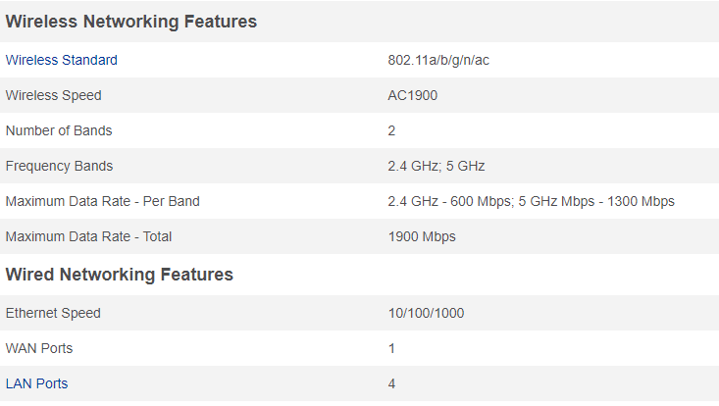
Wireless Printers / Other Devices
It is Netgear's latest router in the company's premium dual-band 802.11ac router line-up. The router looks as cool as its name suggests, with a trapezoid design and flared sides.
Excellent speeds on the 5GHz band when paired with Netgear's latest mini 11ac A6100 USB adapter.
This relates with any other technology out there because a router is basically a small box that allows multiple computers to join the same network, whereas ethernet is for wired connections, most modern routers offer wireless connectivity as well.

Slide 7
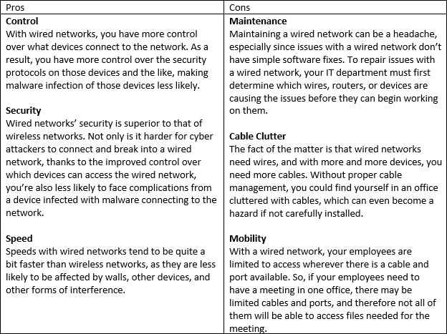
Wireless Printers / Other Devices
Wireless networks are typically set up to use DHCP, where the network router automatically assigns an IP address to computers and other devices.
Wireless network cards and PDAs

Slide 8
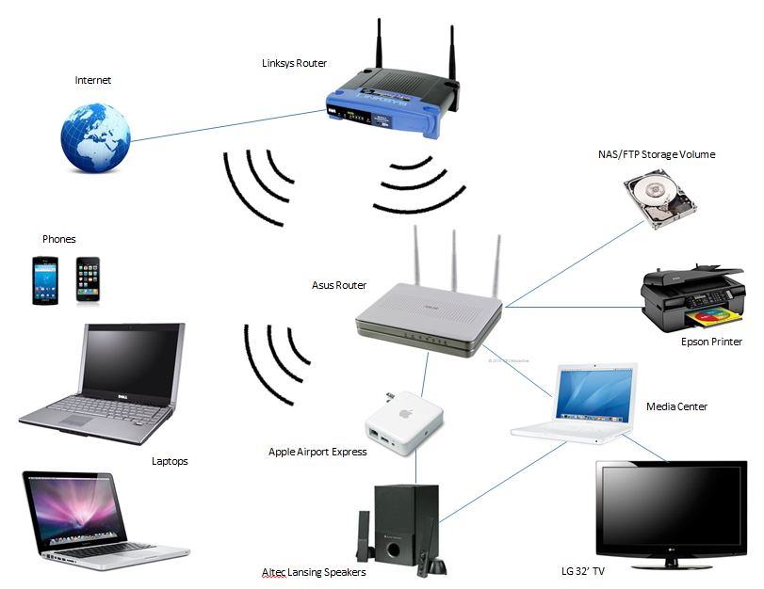
Typical Home Network

